Slide 1
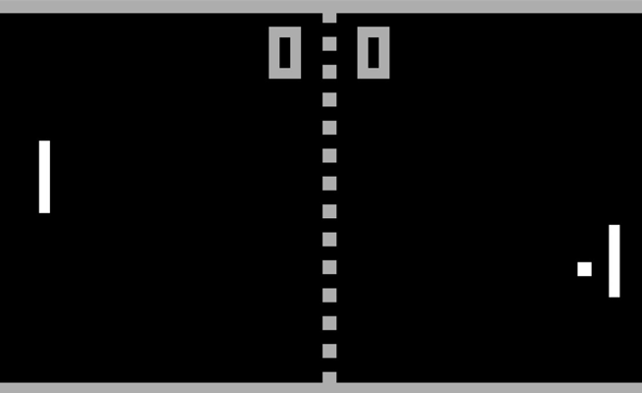
Atari Tennis (Pong)
By Miguel. V and Eric. L

Slide 2
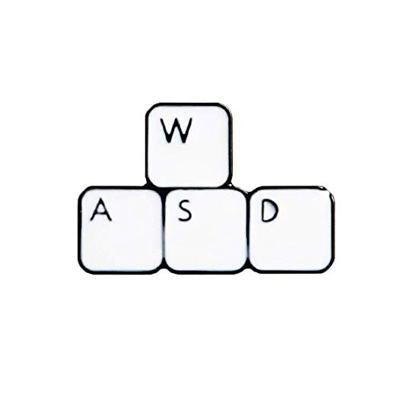
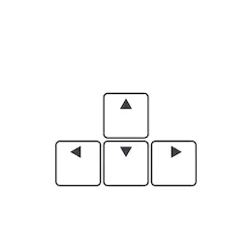
Controls
Players are represented by the rectangular tiles
Player 1:
W - moving the tile up
S - moving the tile down
A - moving the tile up at a faster speed
D - moving the tile down at a faster speed
Player 2
Up arrow - moving the tile up
Down arrow - moving the tile down
Left arrow - moving the tile up at a faster speed
Right arrow - moving the tile down at a faster speed

Slide 3
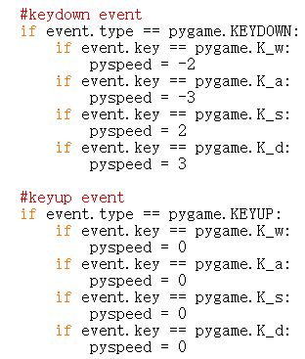
The code for Player 1’s keyboard movements
We programmed the W, S, A, D keys on the keyboard as the movements for player 1:
K_w = W
K_d = D
K_a = A
K_s = S
These codes allow player 1 to move the tile

Slide 4
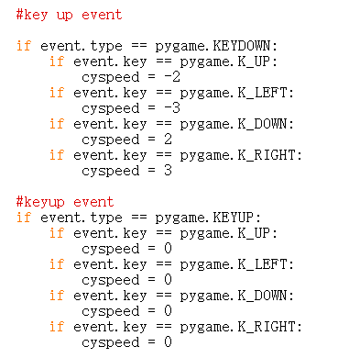
The code for player 2’s keyboard movements
Arrow keys were programmed as the keys for player 2’s movement:
K_UP = up arrow
K_DOWN = down arrow
K_LEFT = left arrow
K_RIGHT = right arrow
These codes allow player 2 to move the tile

Slide 5
The Rules of the Game
A ball will first appear in the middle of the white line, representing the middle of the screen
The ball will first bounce to player 2(on the right)
After either player scores the point, the next serve will belong to the opponent
The game will be up to seven points
The game will end at 7 points and either player does not have to win by 2

Slide 6
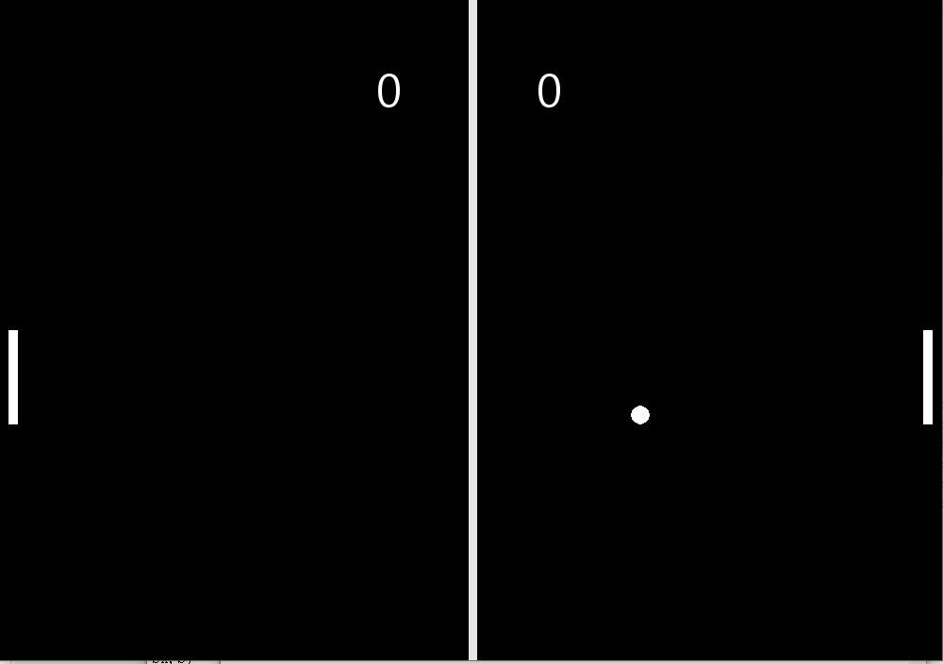
Serves
After the ball bounces to player 2 as the start of the game; player 1 will have to hit the ball back by moving the tile and letting it touch the ball
If player 1 scores a point, player two will be serving next
If player 2 scores a point, player one will be serving next
If player 1 or 2 kept losing, the loser will keep serving until the player scores

Slide 7
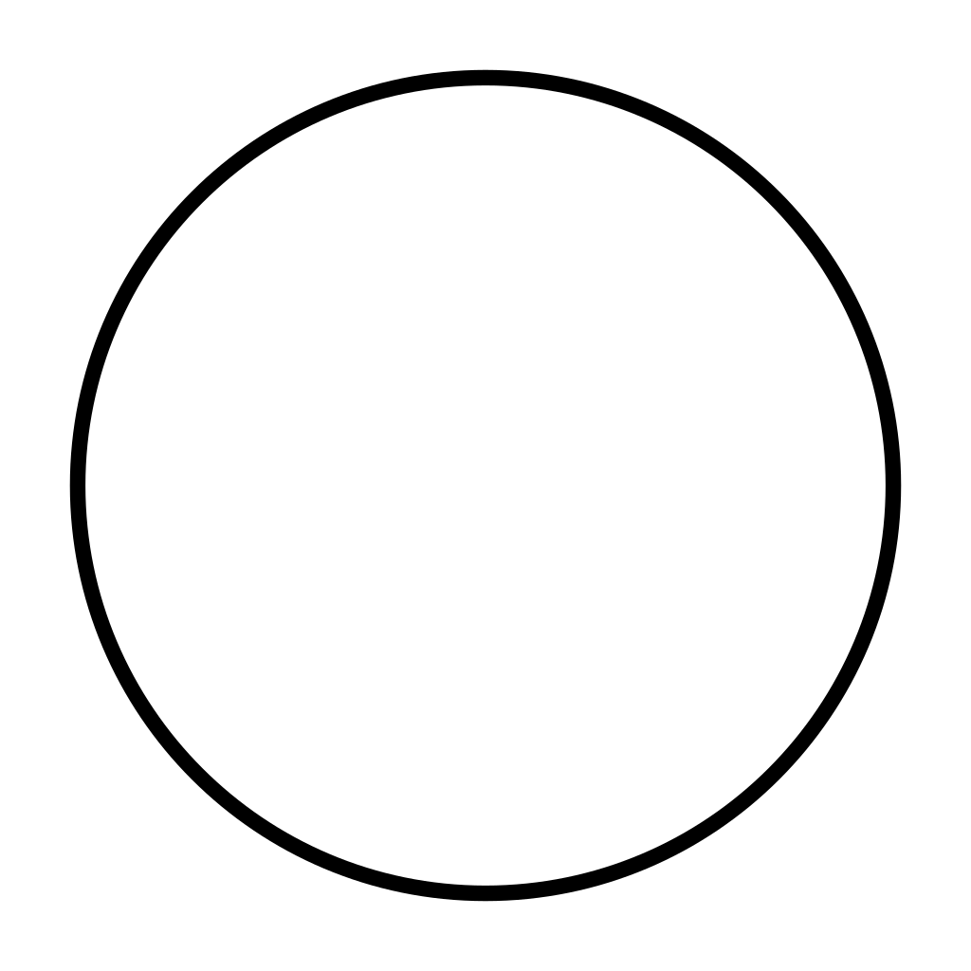
The scoring system
Both players will try to hit the ball with the tile by using the control buttons
If the ball hits the baseline of player 1’s baseline, player 2 scores a point
If the ball hits the baseline of player 2’s baseline, player 1 scores a point
Atari Tennis
|

Slide 8
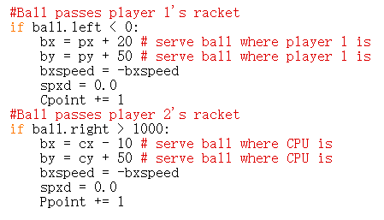
The code of our scoring system
The screen size of our pygame window is 1000 by 700
For player 1 to score, the ball will be touching and passing the x value of the baseline on the left
This means the x value of the ball’s position will have to be below 0(shown on the first section of the code: ball.right > 1000 )
For player 2 to score, the ball will have to touch and pass the the baseline of the right side
The x value of the ball’s position will be exceeding 1000(shown at the second section of the code: ball.left < 0 )

Slide 9
When a score is made by either player, the ball will reappear in front of the centre of the tile
bx = px + 20: moves the ball 20 units to the right of player 1’s tile
bx = cx - 10: moves the ball 10 units to the left of player 2’s tile
The variable Ppoint keeps track of player one’s score
The variable Cpoint keeps track of player two’s score

Slide 10
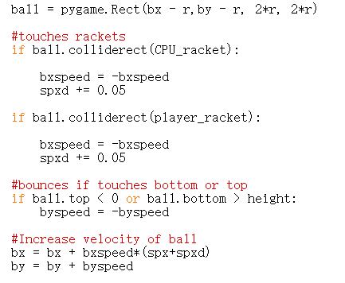
Ball movement
The ball was created by the pygame.Rect function.
When the ball reaches the tile of player 2, the ball will move to the left with the code:
bxspeed = - bxspeed
The ball gains a speed boost after being hit to the opponent’s side
When the ball reaches the tile of player 1, the ball will move to the right

Slide 11
Source of error
We tried to put a CPU instead of another player, but because it was too complicated, we decided to put a second player.
That is why the codes say CPU and not Player_2

Slide 12
More Features
When the ball gets struck by either top or bottom corner of any tiles, it will get a speed boost for the ball that acts like a smash in the actual tennis game
This “smash” has both beneficial and harmful side for either player
The ball has two possibilities in movements:
Moving towards the opponent’s side
Moving towards the player’s own baseline
If the M button on the keyboard is pressed, the game will restart

Slide 13
More Features
Music is random within the game.
The ball moves faster after each hit
It goes back to its normal speed when a point is made
When a game ends, the winner will be displayed on the screen for 6 seconds
After 6 seconds, the game will restart

Slide 14
Websites used for the game
https://downloads.khinsider.com/search?search
https://pythonprogramming.net/pygame-start-menu-tutorial/

Slide 15
Thank You For Listening!

